Slide 1
INVENTORY MANAGEMENT SYSTEM
Suren Sritharan : E/14/379
Harshana Sumedha Weligampola : E/14/339
Gihan Chanaka Jayatilaka : E/14/158

Slide 2
OBJECTIVES
Develop a decision support system: Stores data Process data Assist in decision making

Slide 3
OBJECTIVES ACHIEVED
Built the database.
Built the GUI to facilitate
Seller/ Buyer data addition, analysis and prediction.
Developed a prediction model and a data generation model to test the system.

Slide 4
BREAKDOWN
Implementing the database:
Used mySQL
Implementing the GUI:
Python tkinter
Implementing the algorithms:
Python, Numpy

Slide 5
BREAKDOWN ..
Connecting the GUI to the database
Pymysql
Collaboration
https://github.com/suren3141/CO226_IMS

Slide 6
OUR IMPLEMENTATION
Database
Algorithm
Gui

Slide 7
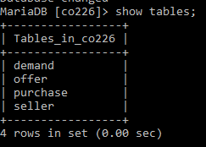
DATABASE

Slide 8
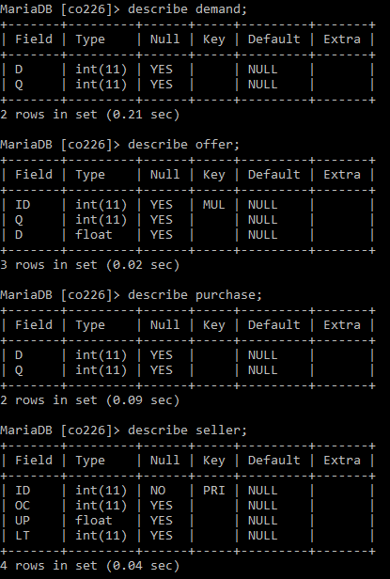
DATABASE

Slide 9
ALGORITHM
Generating the historical sales data
Sales have a poisson distribution
BUT
Sales have a seasonal variation

Slide 10
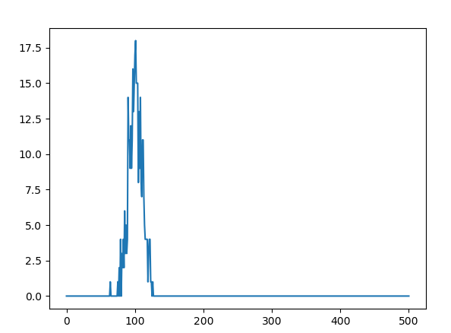
No of days with a particular no of sales -- Average sales per day =100

Slide 11
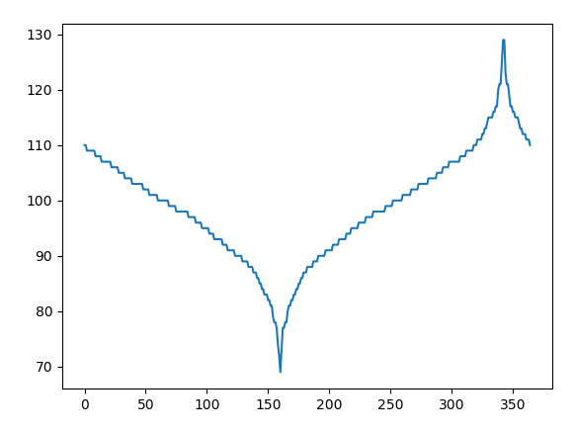
Seasonal distribution of sales

Slide 12
ALGORITHM
Desired tolerance of customer satisfaction
Predicting when stocks run out
HISTORICAL DATA
Calculating the sample parameters
POISSON MODEL
When to order stocks?

Slide 13
GUI
Demonstration>>>

